Slide 1


Slide 2
The average marks per student in a class of 30 students were 45. On rechecking it was found that marks had been entered wrongly in two cases. After correction these marks were increased by 24 and 34 in the two cases. The correct average marks per student are
(a) 75 (b) 60
(c) 56 (d) 47
[NIMCET 2010]

Slide 3
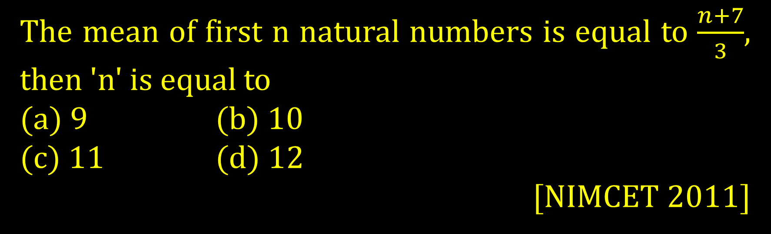
The mean of first n natural numbers is equal to $\frac{n+7}{3}$, then 'n' is equal to
(a) 9 (b) 10
(c) 11 (d) 12
[NIMCET 2011]

Slide 4
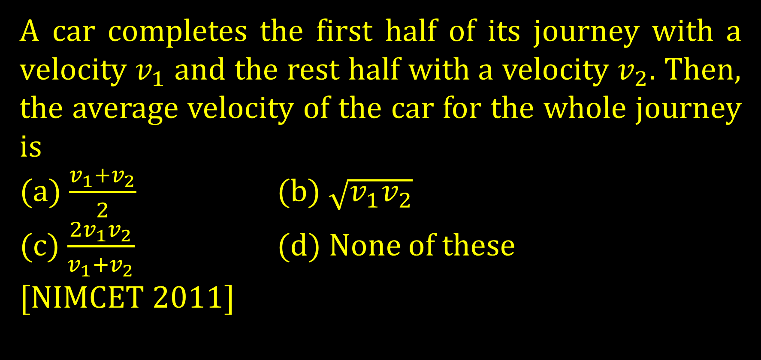
A car completes the first half of its journey with a velocity $v_{1}$ and the rest half with a velocity $v_{2}$. Then, the average velocity of the car for the whole journey is
(a) $\frac{v_{1}+v_{2}}{2}$ (b) $\sqrt{v_{1}v_{2}}$
(c) $\frac{2v_{1}v_{2}}{v_{1}+v_{2}}$ (d) None of these
[NIMCET 2011]

Slide 5
Two variables have least square regression lines 3x+2y=26 and 6x+y=31, then correlation between x and y is
(a) 0.5 (b) 0.7
(c) - 0.7 (d) -0.5
[NIMCET 2011]

Slide 6
If the mean of the squares of first n natural numbers be 11, then n is equal to
(a) -13/2 (b) 11
(c) 5 (d) 4
[NIMCET 2011]

Slide 7
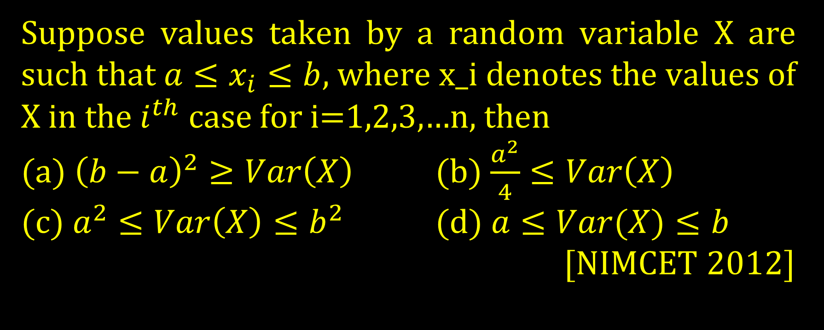
Suppose values taken by a random variable X are such that $a≤x_{i}≤b$, where x_i denotes the values of X in the $i^{th}$ case for i=1,2,3,…n, then
(a) ${\left(b−a\right)}^{2}≥Var\left(X\right)$ (b) $\frac{a^{2}}{4}≤Var\left(X\right)$
(c) $a^{2}≤Var\left(X\right)≤b^{2}$ (d) $a≤Var(X)≤b$
[NIMCET 2012]

Slide 8
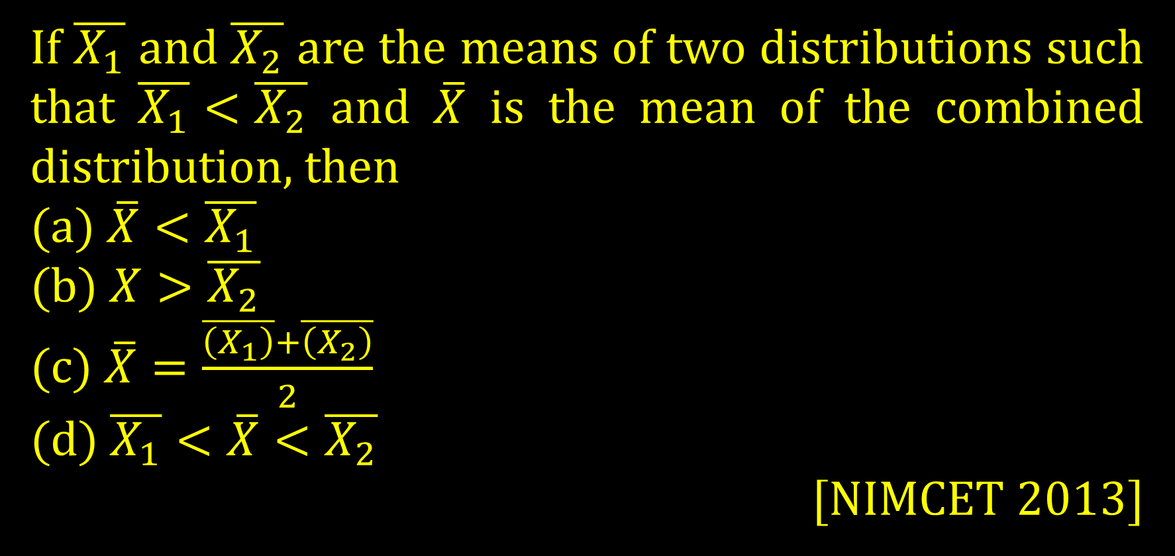
If $\overline{X_{1}}$ and $\overline{X_{2}}$ are the means of two distributions such that $\overline{X_{1}}<\overline{X_{2}}$ and $\overline{X}$ is the mean of the combined distribution, then
(a) $\overline{X}<\overline{X_{1}}$
(b) $X>\overline{X_{2}}$
(c) $\overline{X}=\frac{\overline{\left(X_{1}\right)}+\overline{\left(X_{2}\right)}}{2}$
(d) $\overline{X_{1}}<\overline{X}<\overline{X_{2}}$
[NIMCET 2013]

Slide 9
The average marks of boys in a class is 52 and that of girls is 42. The average marks of boys and girls combined is 50. The Percentage of boys in the class is
(a) 80% (b) 60%
(c) 40% (d) 20%
[NIMCET 2016, 2014]

Slide 10
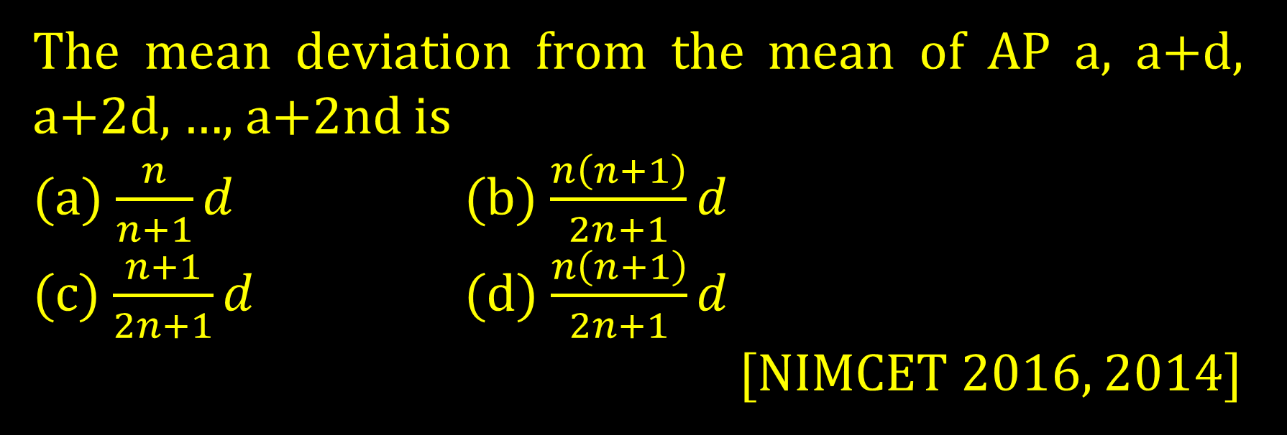
The mean deviation from the mean of AP a, a+d, a+2d, …, a+2nd is
(a) $\frac{n}{n+1}d$ (b) $\frac{n\left(n+1\right)}{2n+1}d$
(c) $\frac{n+1}{2n+1}d$ (d) $\frac{n\left(n+1\right)}{2n+1}d$
[NIMCET 2016, 2014]

Slide 11
In a group of 200 students, the mean and standard deviation of scores were found to be 40 and 15, respectively. Later on it was found that two scores 43 and 35 were misread as 34 and 53, respectively. The corrected mean of scores is
(a) 40.95 (b) 39.0
(c) 39.95 (d) 14.97
[NIMCET 2014]

Slide 12
If the mean deviation of the number 1, 1+d, 1+2d, ….. 1+100d from their mean is 225, then the value of d is
(a) 20.0 (b) 10.1
(c) 20.2 (d) 10.0
[NIMCET 2019, 2015]

Slide 13
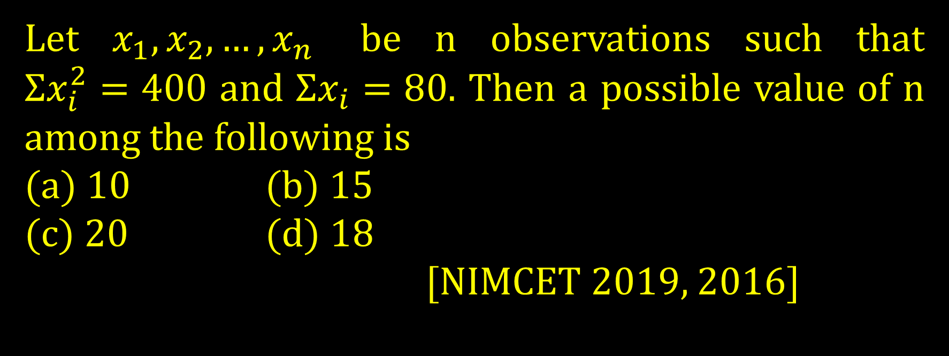
Let $x_{1},x_{2},…,x_{n}$ be n observations such that $Σx_{i}^{2}=400$ and $Σx_{i}=80$. Then a possible value of n among the following is
(a) 10 (b) 15
(c) 20 (d) 18
[NIMCET 2019, 2016]

Slide 14
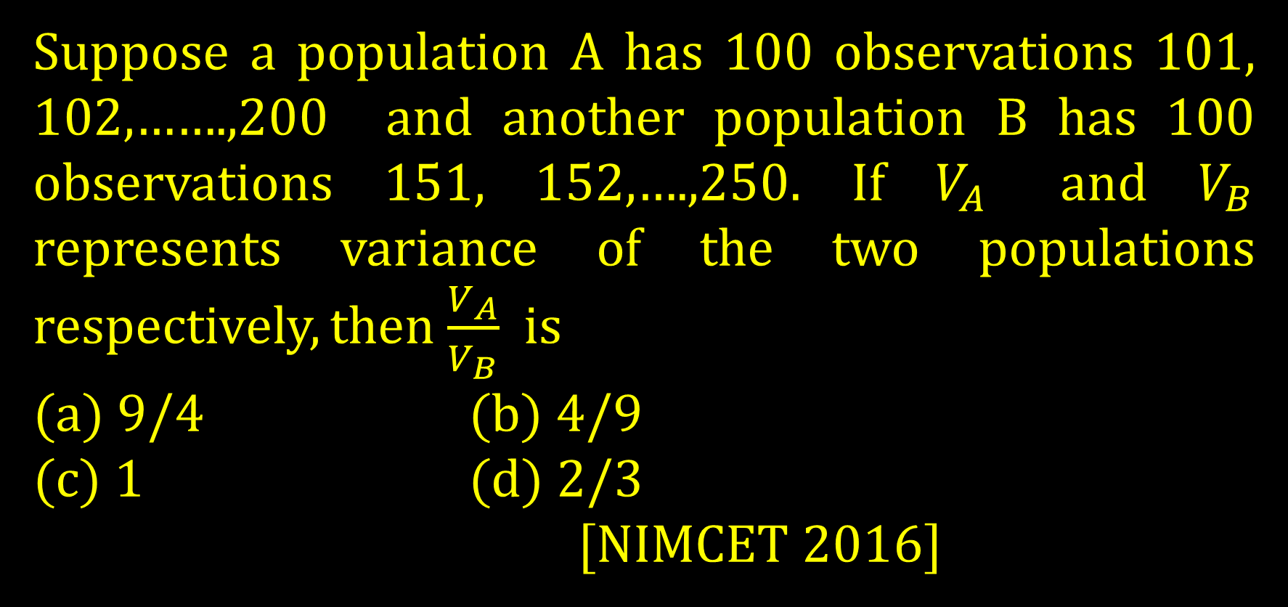
Suppose a population A has 100 observations 101, 102,…….,200 and another population B has 100 observations 151, 152,….,250. If $V_{A}$ and $V_{B}$ represents variance of the two populations respectively, then $\frac{V_{A}}{V_{B}}$ is
(a) 9/4 (b) 4/9
(c) 1 (d) 2/3
[NIMCET 2016]

Slide 15
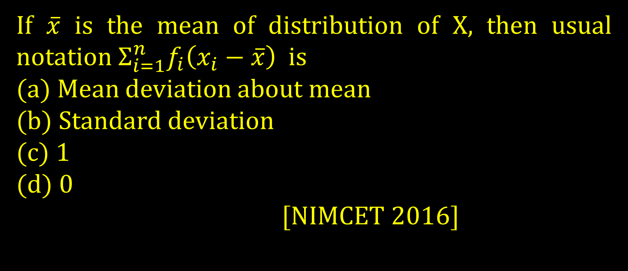
If $\overline{x}$ is the mean of distribution of X, then usual notation $Σ_{i=1}^{n}f_{i}\left(x_{i}−\overline{x}\right)$ is
(a) Mean deviation about mean
(b) Standard deviation
(c) 1
(d) 0
[NIMCET 2016]

Slide 16
If the mean of the squares of the first n natural numbers be 11, then n is equal to
(a) -13/2 (b) 11
(c) 5 (d) 4
[NIMCET 2018]

Slide 17
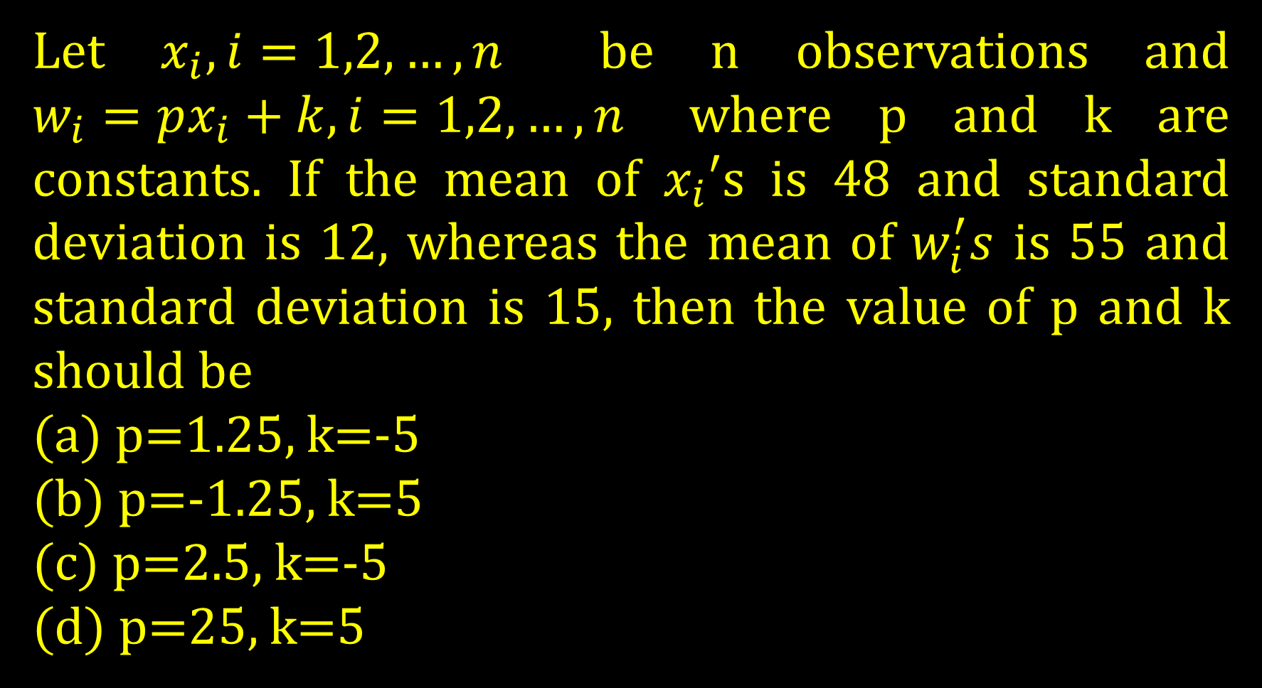
Let $x_{i},i=1,2,…,n$ be n observations and $w_{i}=px_{i}+k,i=1,2,…,n$ where p and k are constants. If the mean of $x_{i}′$s is 48 and standard deviation is 12, whereas the mean of $w_{i}^{′}s$ is 55 and standard deviation is 15, then the value of p and k should be
(a) p=1.25, k=-5
(b) p=-1.25, k=5
(c) p=2.5, k=-5
(d) p=25, k=5

Slide 18
Standard deviation for the following distribution is
Size of item 6 7 8 9 10 11 12
Frequency 3 6 9 13 8 5 4
(a) 1.607 (b) 9.0
(c) 1.6 (d) 1.88
[NIMCET 2020]

Slide 19
A, B, C are three sets of values of x:
A: 2,3,7,1,3,2,3
B: 7,5,9,12,5,3,8
C: 4,4,11,7,2,3,4
Select the correct statement among the following:
(a) Mean of A is equal to Mode of C.
(b) Mean of C is equal to Median of B.
(c) Median of B is equal to Mode of A.
(d) Mean, Median and Mode of A are same.
[NIMCET 2020]

Slide 20
The mean of 5 observation is 5 and their variance is 124. If three of the observations are 1, 2, 6, then the mean deviation from the mean of the data is
(a) 2.5 (b) 2.6
(c) 2.8 (d) 2.4
[NIMCET 2019]

Slide 21
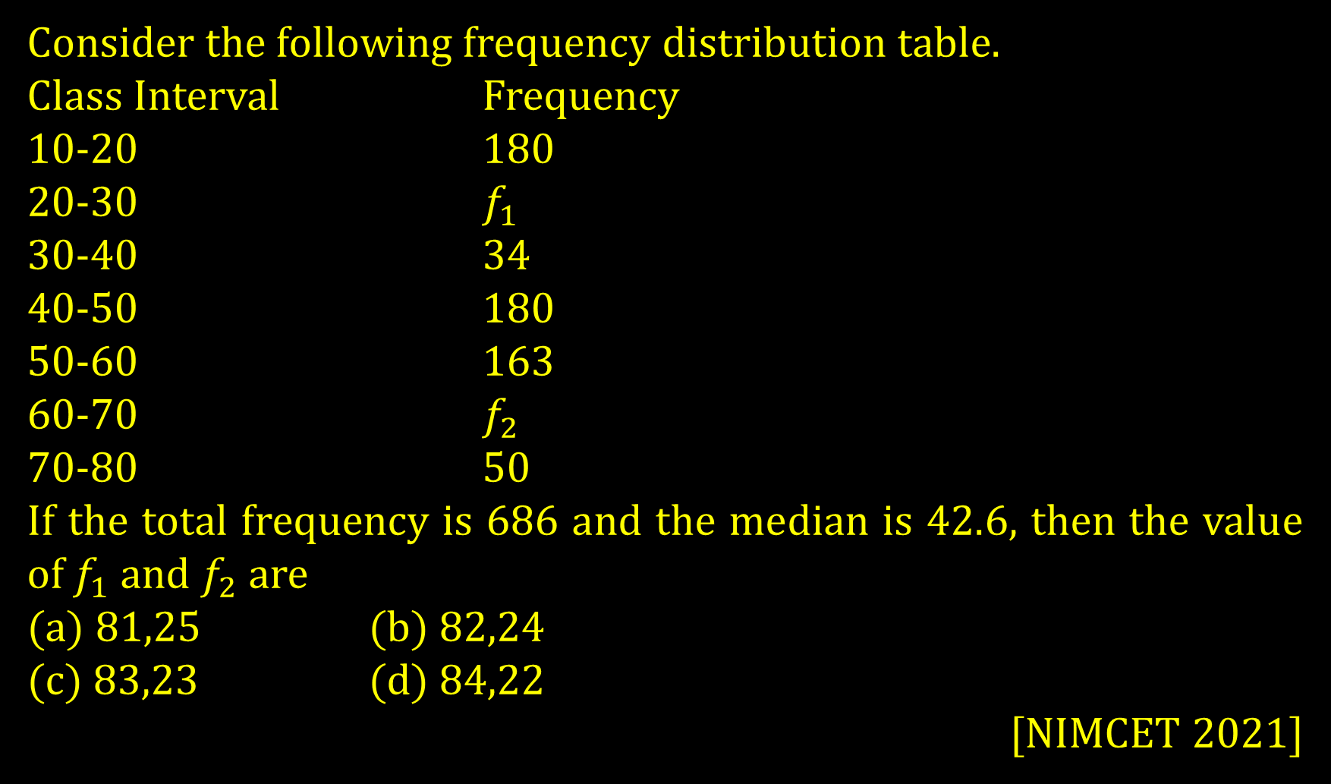
Consider the following frequency distribution table.
Class Interval Frequency
10-20 180
20-30 $f_{1}$
30-40 34
40-50 180
50-60 163
60-70 $f_{2}$
70-80 50
If the total frequency is 686 and the median is 42.6, then the value of $f_{1}$ and $f_{2}$ are
(a) 81,25 (b) 82,24
(c) 83,23 (d) 84,22
[NIMCET 2021]

Slide 22
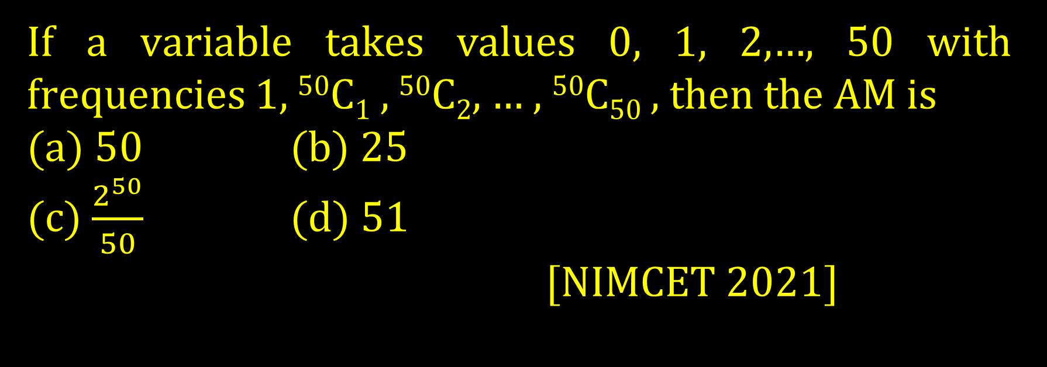
If a variable takes values 0, 1, 2,…, 50 with frequencies 1, ⁵⁰C₁ , ⁵⁰C₂, … , ⁵⁰C₅₀ , then the AM is
(a) 50 (b) 25
(c) $\frac{2^{50}}{50}$ (d) 51
[NIMCET 2021]

Slide 23
The standard deviation of 20 numbers is 30. If each of the numbers is increased by 4, then the new standard deviation will be
(a) 24 (b) 34
(c) 30 (d) 20
[NIMCET 2021]

Slide 24
The mean of 25 observations was found to be 38. It was later discovered that 23 and 38 were misread as 25 and 36, then the mean is
(a) 32 (b) 36
(c) 38 (d) 42
[NIMCET 2022]

Slide 25
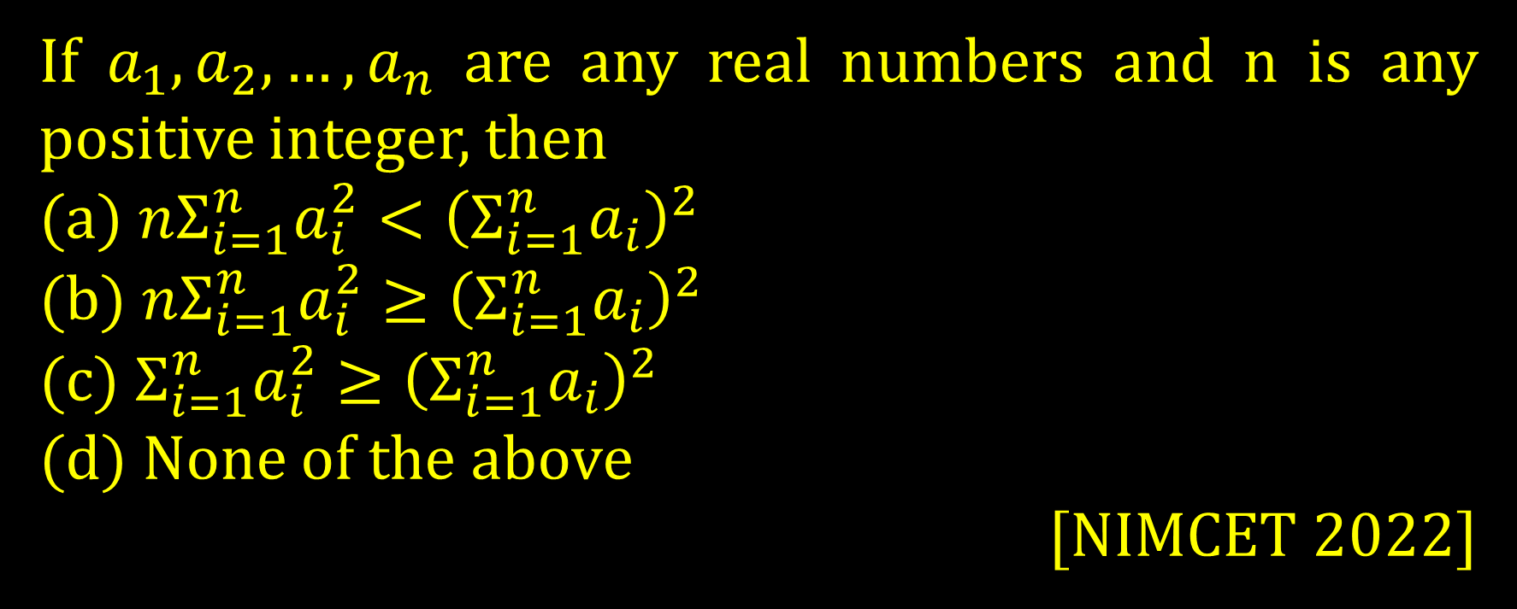
If $a_{1},a_{2},…,a_{n}$ are any real numbers and n is any positive integer, then
(a) $nΣ_{i=1}^{n}a_{i}^{2}<{\left(Σ_{i=1}^{n}a_{i}\right)}^{2}$
(b) $nΣ_{i=1}^{n}a_{i}^{2}≥{\left(Σ_{i=1}^{n}a_{i}\right)}^{2}$
(c) $Σ_{i=1}^{n}a_{i}^{2}≥{\left(Σ_{i=1}^{n}a_{i}\right)}^{2}$
(d) None of the above
[NIMCET 2022]

Slide 26
The first three moments of a distribution about 2 are 1, 16, -40 respectively. The mean and variance of the distribution are
(a) (2,16) (b) (2,15)
(c) (3,15) (d) (1,16)
[NIMCET 2022]

Slide 27
The 10th and 50th percentiles of the observation 32, 49, 23, 29, 118 respectively are
(a) 21, 32 (b) 23, 32
(c) 23, 33 (d) 22, 31
[NIMCET 2022]

